Slide 1
UNIT -2
Number Representation

Slide 2
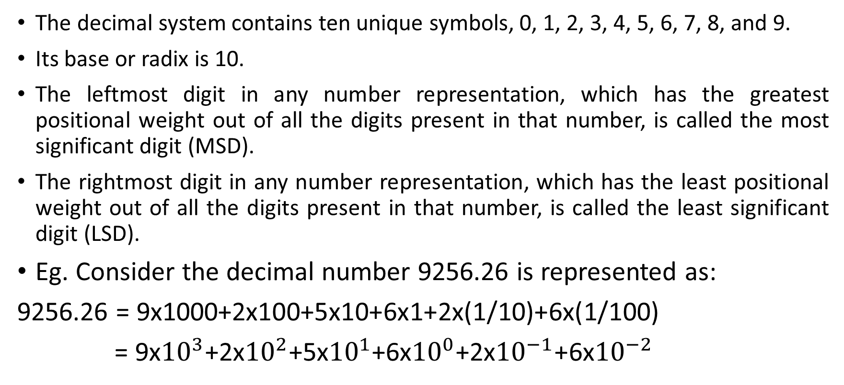
Decimal number system
The decimal system contains ten unique symbols, 0, 1, 2, 3, 4, 5, 6, 7, 8, and 9.
Its base or radix is 10.
The leftmost digit in any number representation, which has the greatest positional weight out of all the digits present in that number, is called the most significant digit (MSD).
The rightmost digit in any number representation, which has the least positional weight out of all the digits present in that number, is called the least significant digit (LSD).
Eg. Consider the decimal number 9256.26 is represented as:
9256.26 = 9x1000+2x100+5x10+6x1+2x(1/10)+6x(1/100)
= 9x${10}^{3}$+2x${10}^{2}$+5x${10}^{1}$+6x${10}^{0}$+2x${10}^{−1}$+6x${10}^{−2}$

Slide 3
Subtraction of decimal numbers can be accomplished by the 9’s and 10’s complement methods.
Similar to the 1’s and 2’s complement methods of binary.
The 9’s complement of a decimal number is obtained by subtracting each digit of that decimal number from 9.
The 10’s complement of a decimal number is obtained by adding a 1 to its 9’s complement.

Slide 4
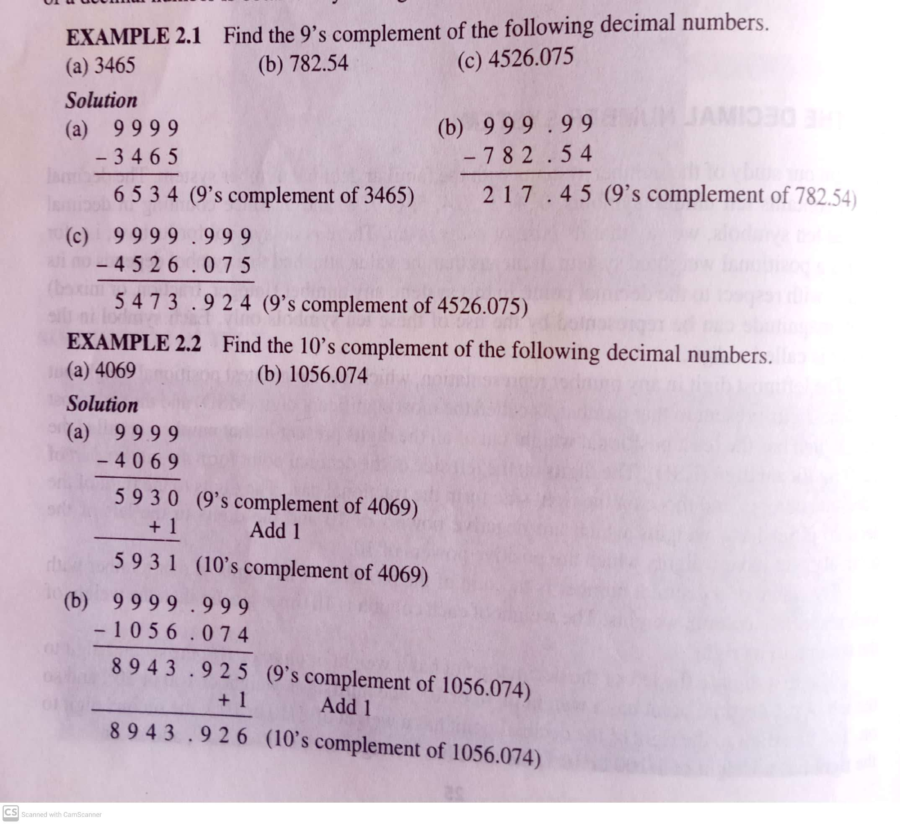

Slide 5
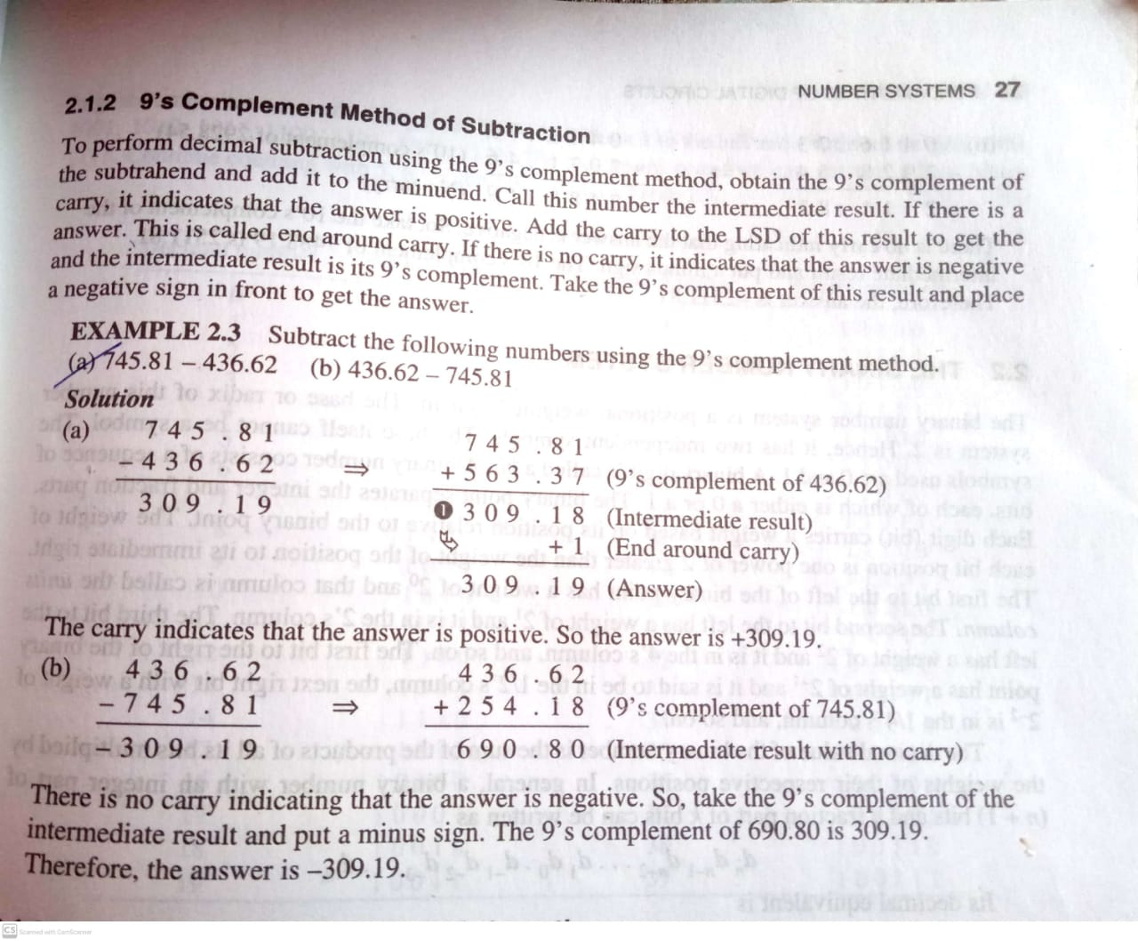

Slide 6
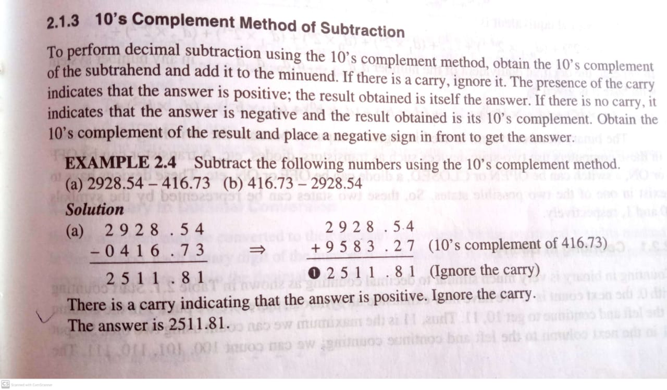
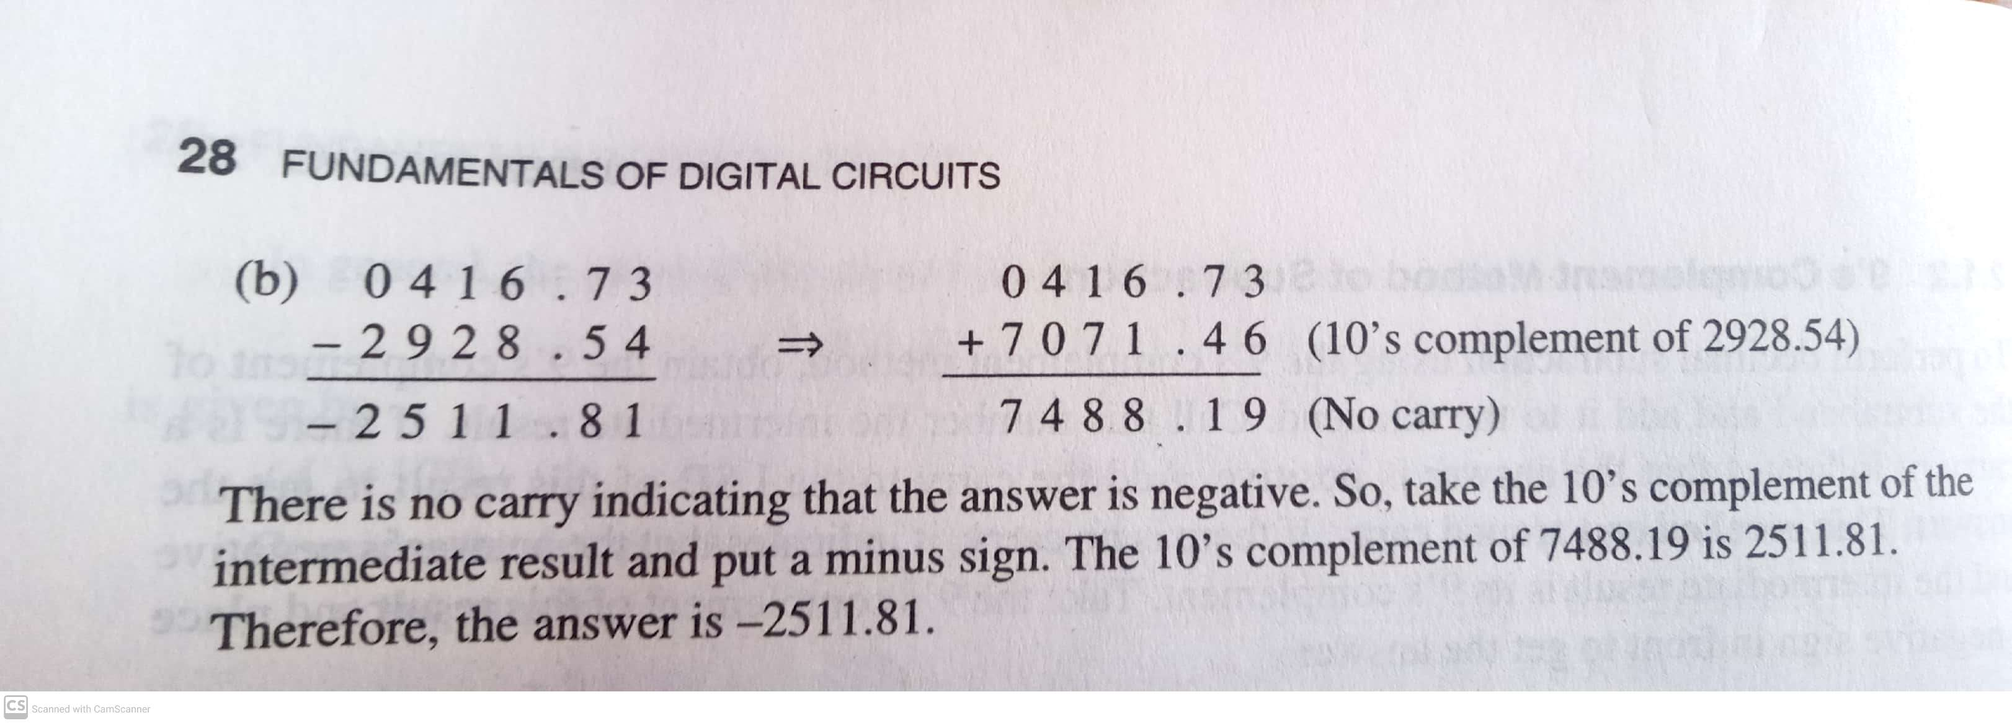

Slide 7
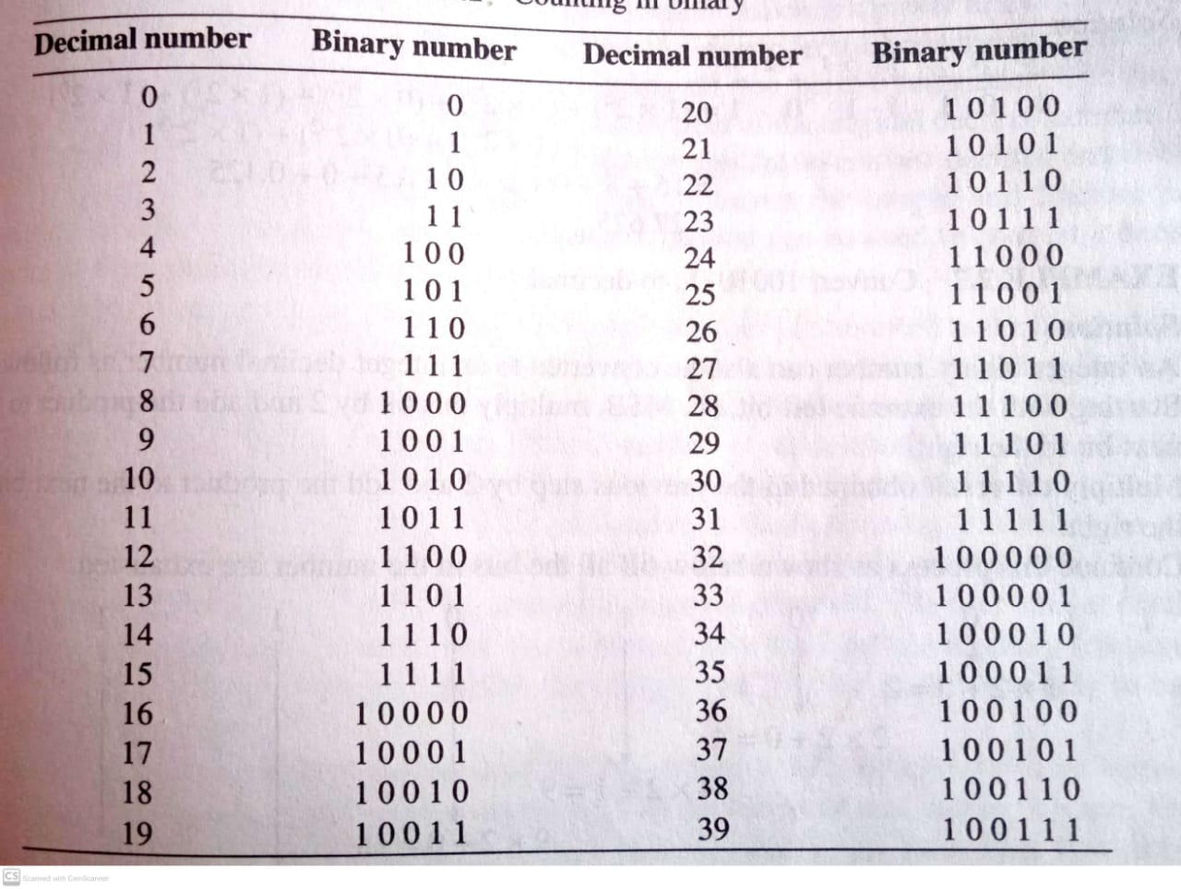
Binary number system

Slide 8
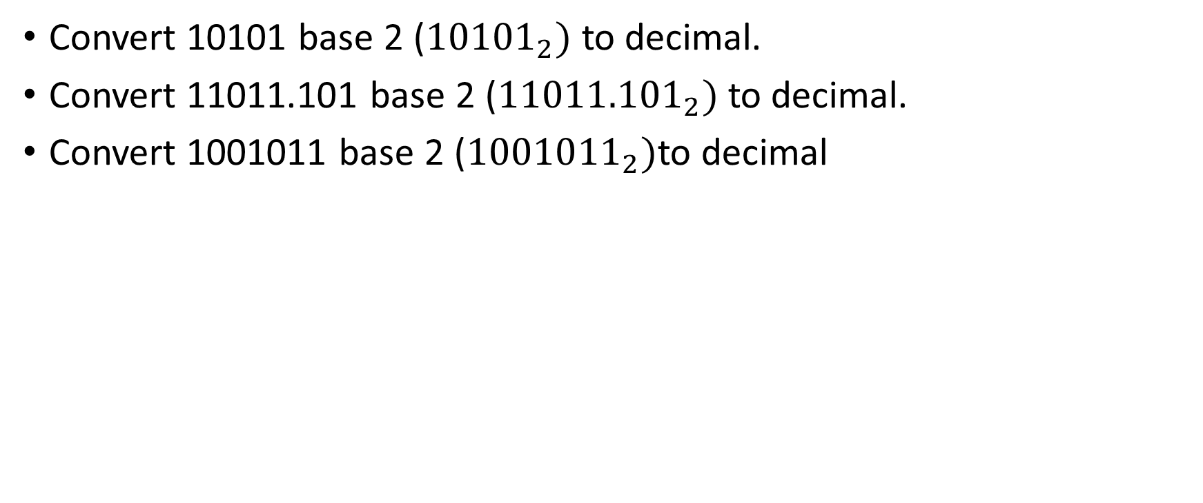
Binary to decimal conversion
Convert 10101 base 2 (${10101}_{2})$to decimal.
Convert 11011.101 base 2 (${11011.101}_{2})$to decimal.
Convert 1001011 base 2 (${1001011}_{2})$to decimal

Slide 9
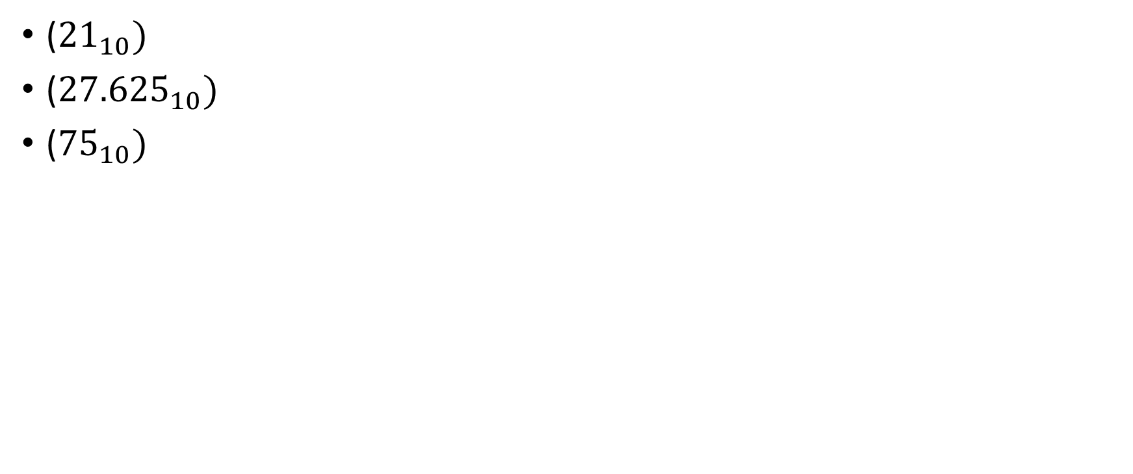
Answers:
(${21}_{10})$
(${27.625}_{10})$
(${75}_{10})$

Slide 10
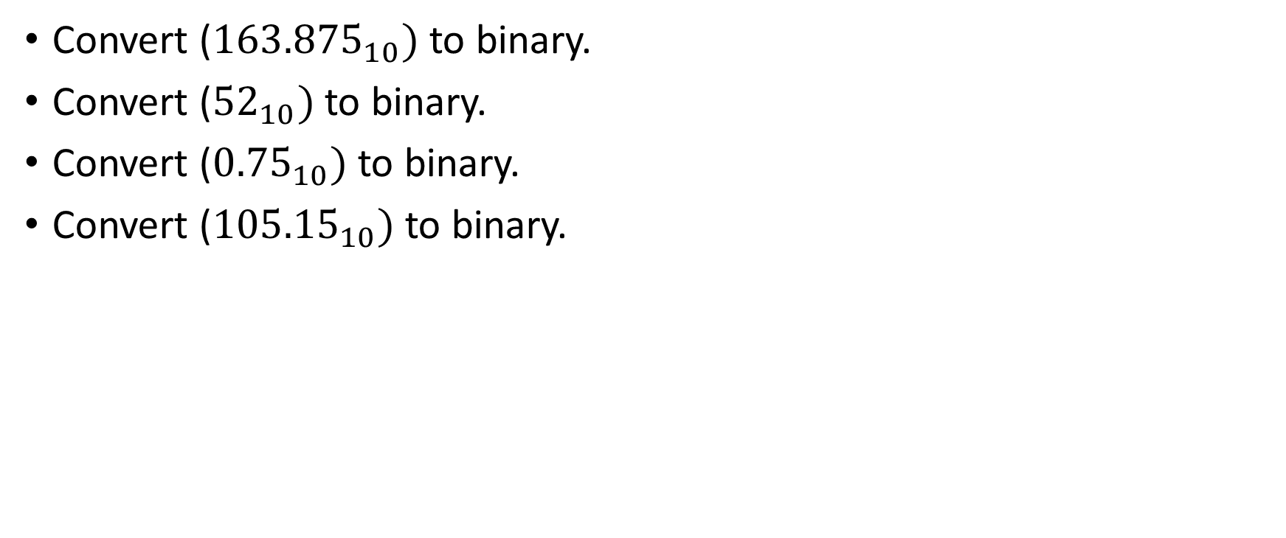
Decimal to binary conversion
Convert (${163.875}_{10})$ to binary.
Convert (${52}_{10})$ to binary.
Convert (${0.75}_{10})$ to binary.
Convert (${105.15}_{10})$ to binary.

Slide 11
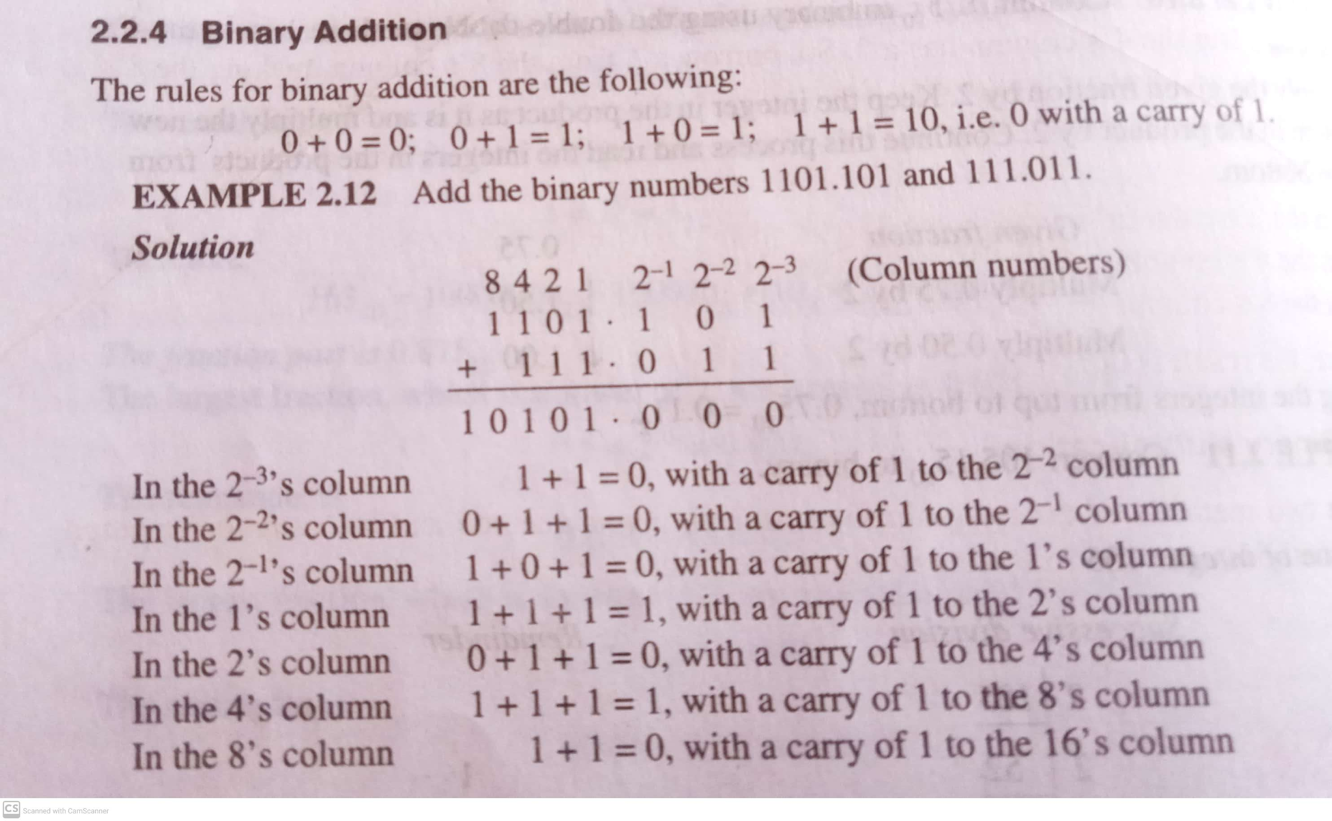
Binary Addition

Slide 12
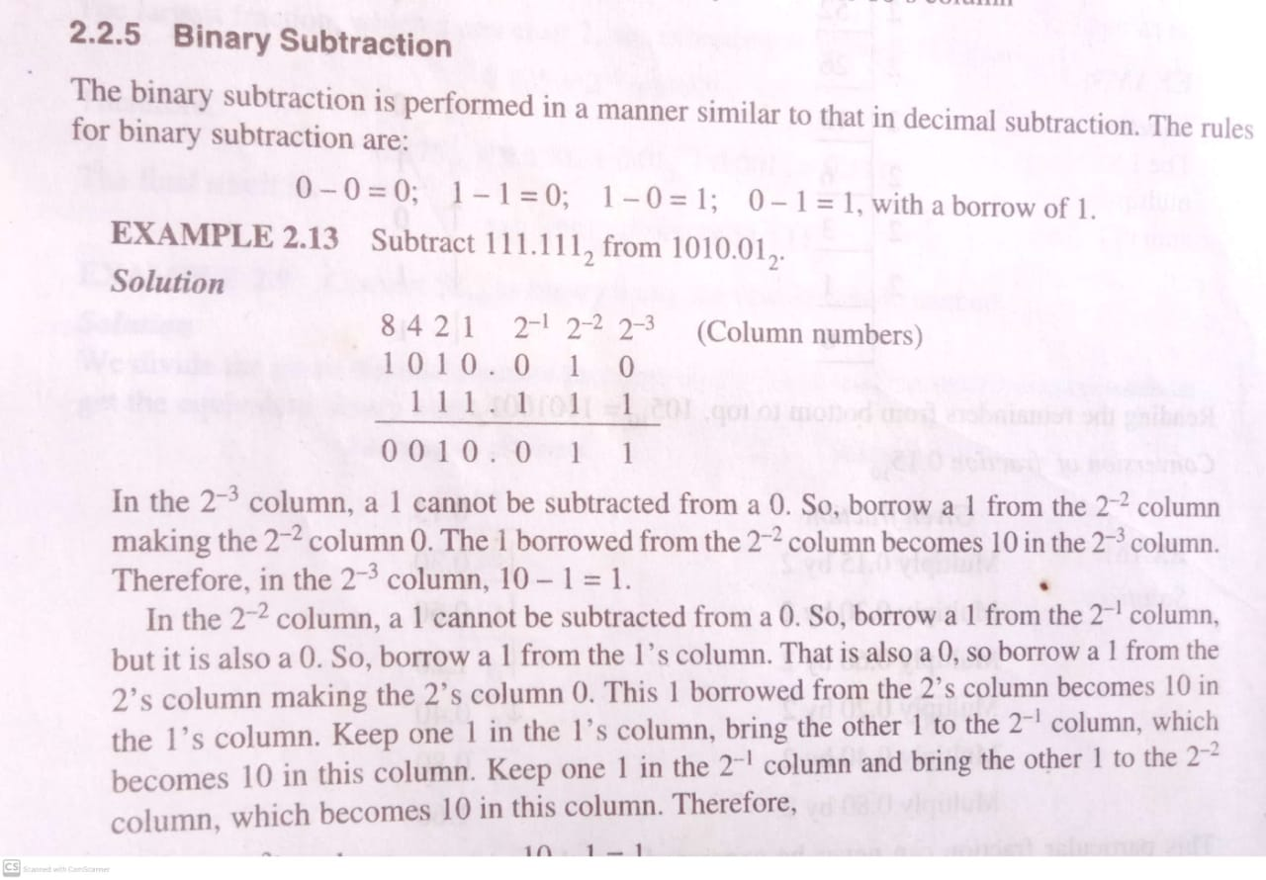
Binary Subtraction

Slide 13
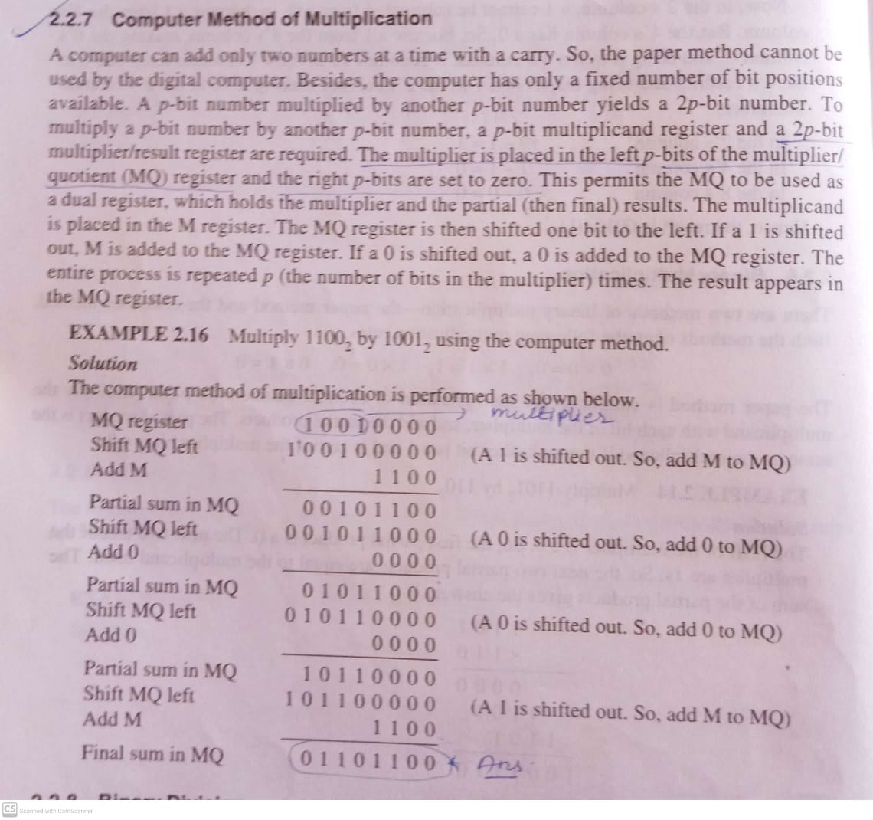
Binary Multiplication

Slide 14
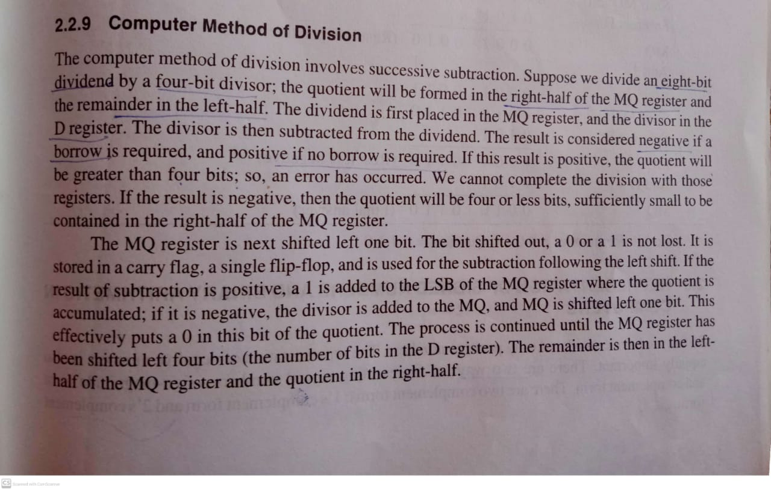
Binary Division

Slide 15
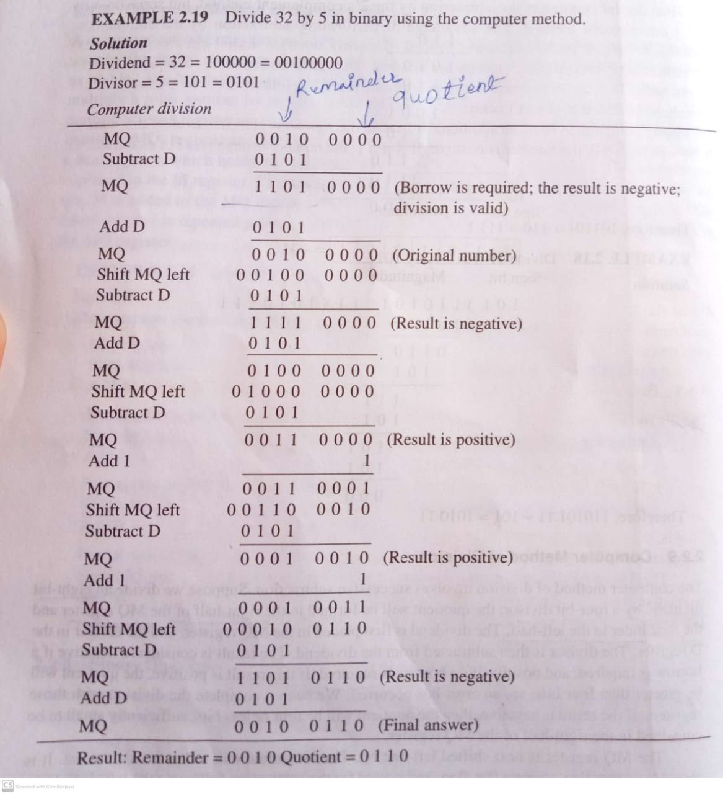

Slide 16
Representation of signed numbers and binary arithmetic
1. Signed magnitude (+ve , -ve).
2. Complement method (1’s complement, 2’s complement).

Slide 17
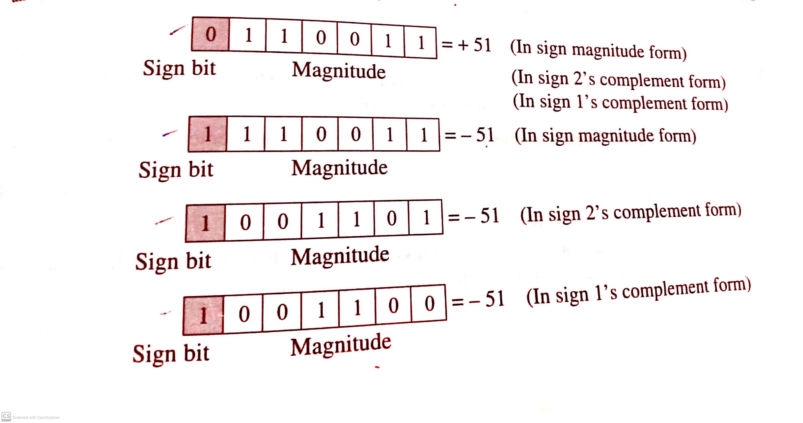

Slide 18
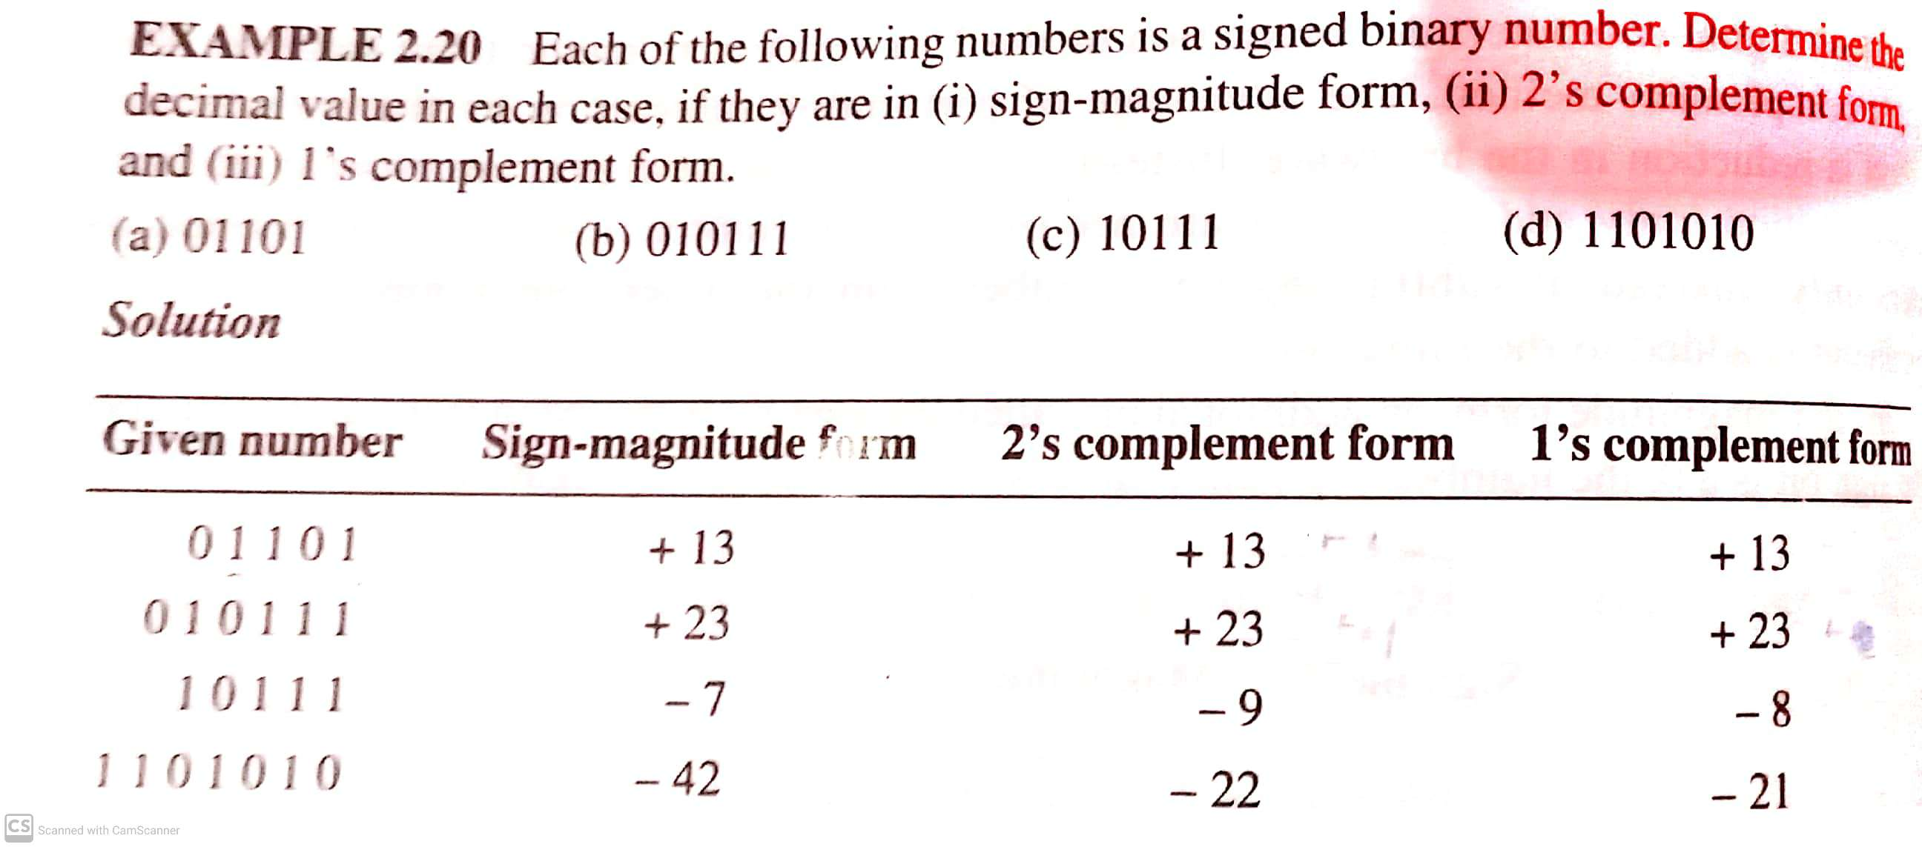

Slide 19
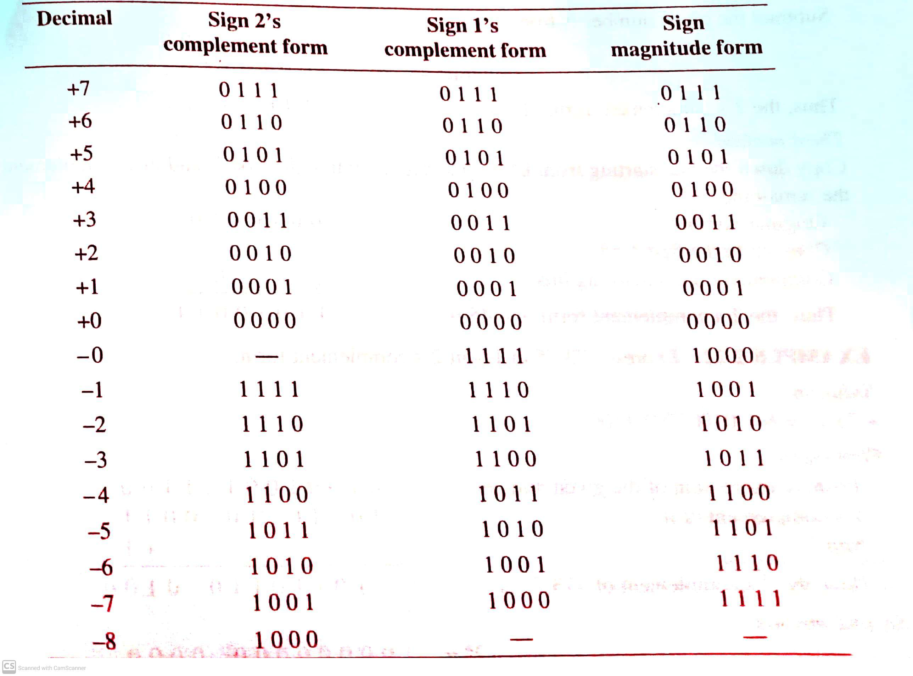

Slide 20
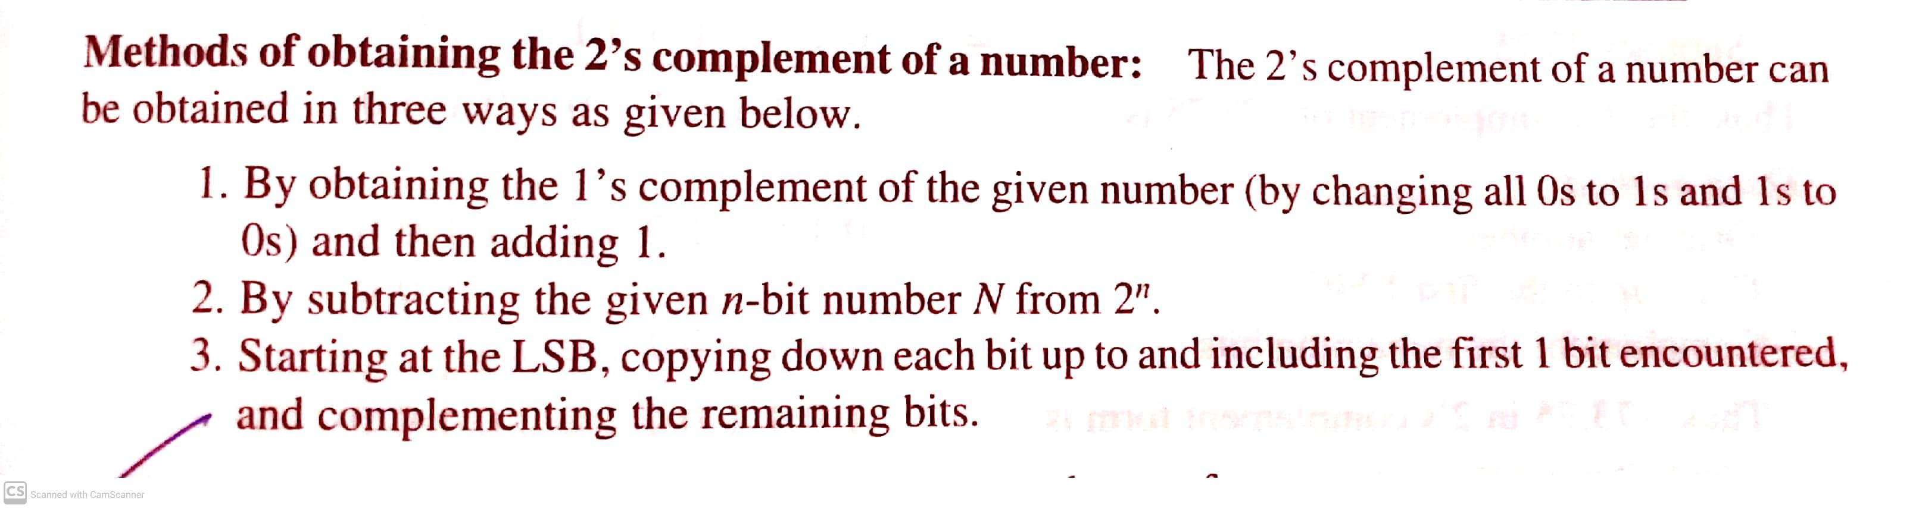

Slide 21
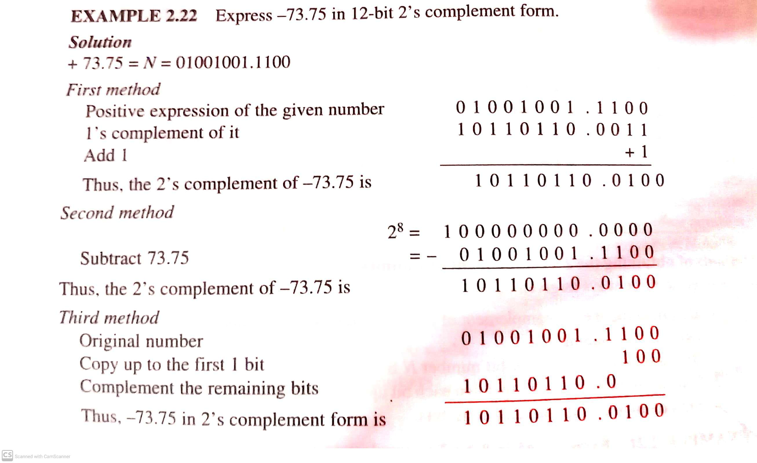

Slide 22
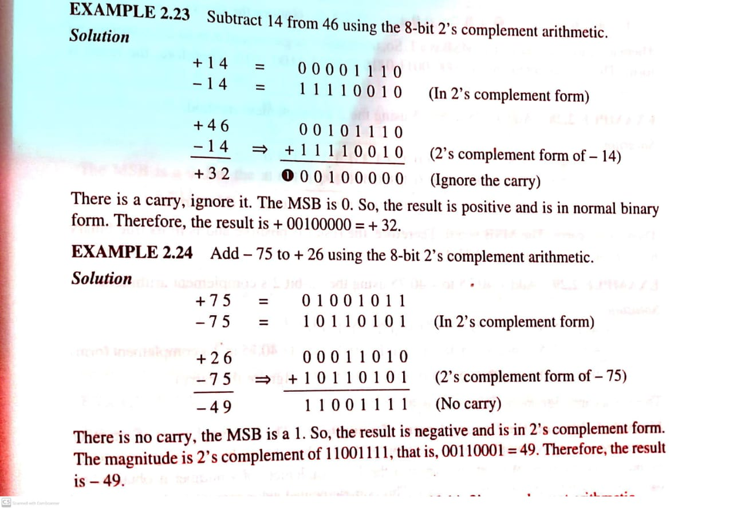

Slide 23
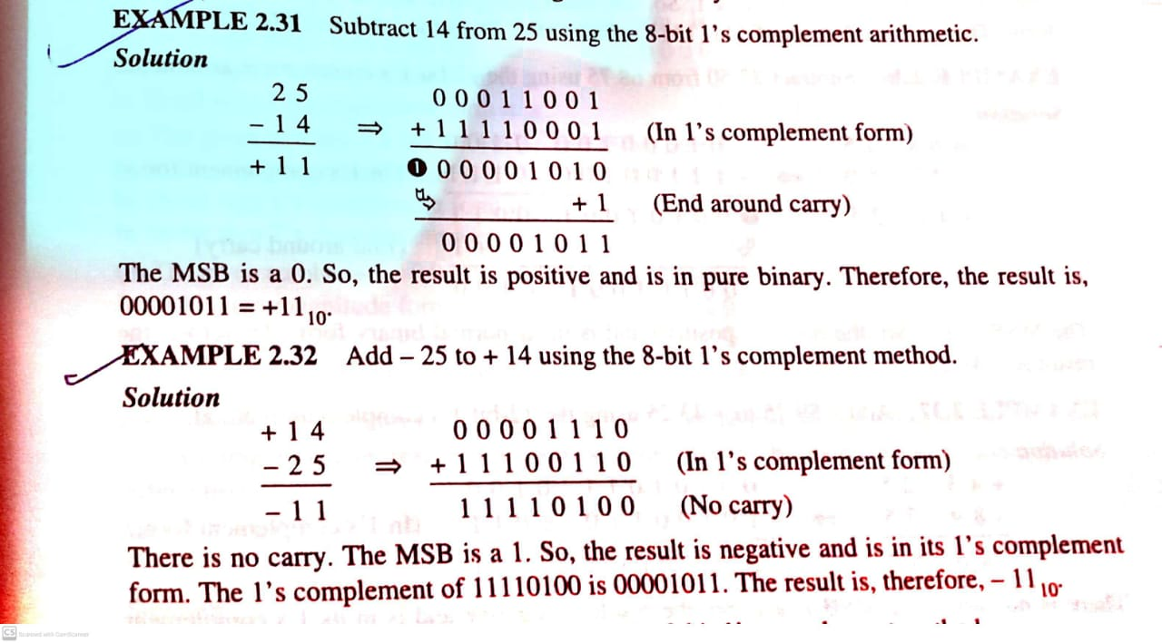

Slide 24
Booth Algorithm
Division Algorithm
→Restoring algorithm
→Non-Restoring algorithm

Slide 25
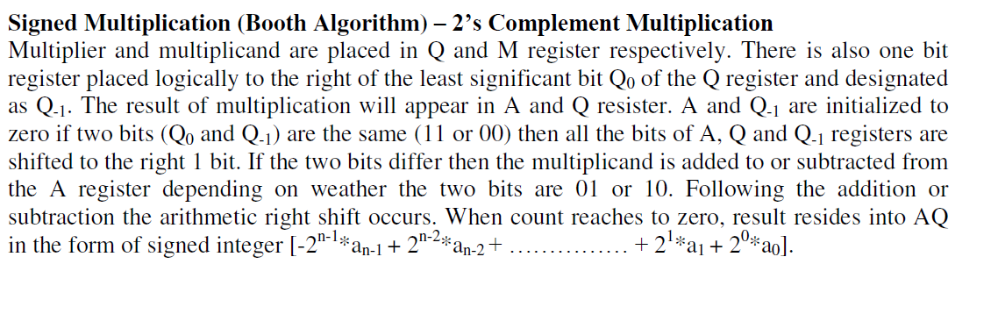

Slide 26
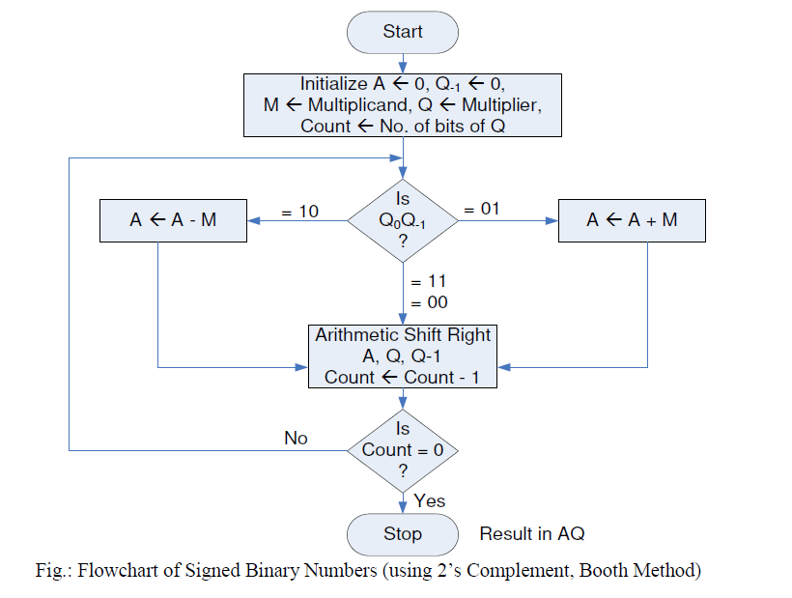

Slide 27
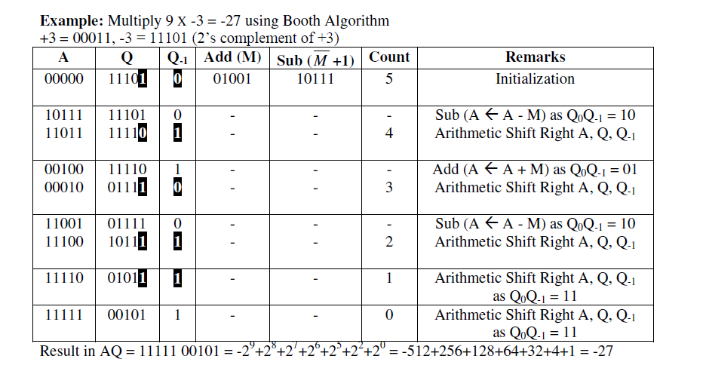

Slide 28
Division Algorithm: Hardware Algorithm

Slide 29
Types of Division Method
Restoring Division Method
Non-Restoring Division Method

Slide 30
What is Restoring method?
The hardware method just described is called the RESTORING METHOD. The reason for the name is that the partial remainder is restored by adding the divisor to the negative difference. Two other methods are available for dividing numbers, the COMPARISION method and the NONRESTORING method. In the comparison method A and B are compared prior to the subtraction operation .
No restoring method B is not added if the difference is negative but instead, the negative difference is shifted left and then B is added.

Slide 31
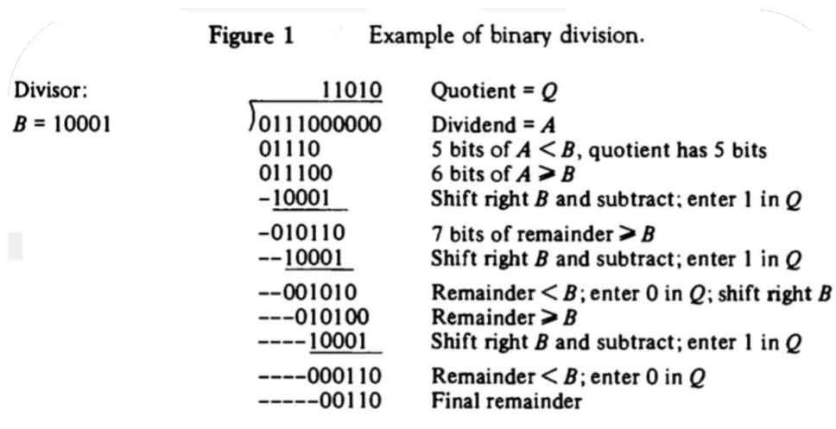
Division Algorithm: Paper-pen Method
Division of two fixed-point binary numbers in signed magnitude representation is done with paper and pencil by a process of successive compare ,shift ,and subtract operations.
Hardware implantation of signed magnitude data

Slide 32
Hardware algorithm
Binary division
Dividend = divisor × quotient + remainder
Given dividend and divisor, we want to obtain quotient (Q)
We will start from our paper & pencil method

Slide 33
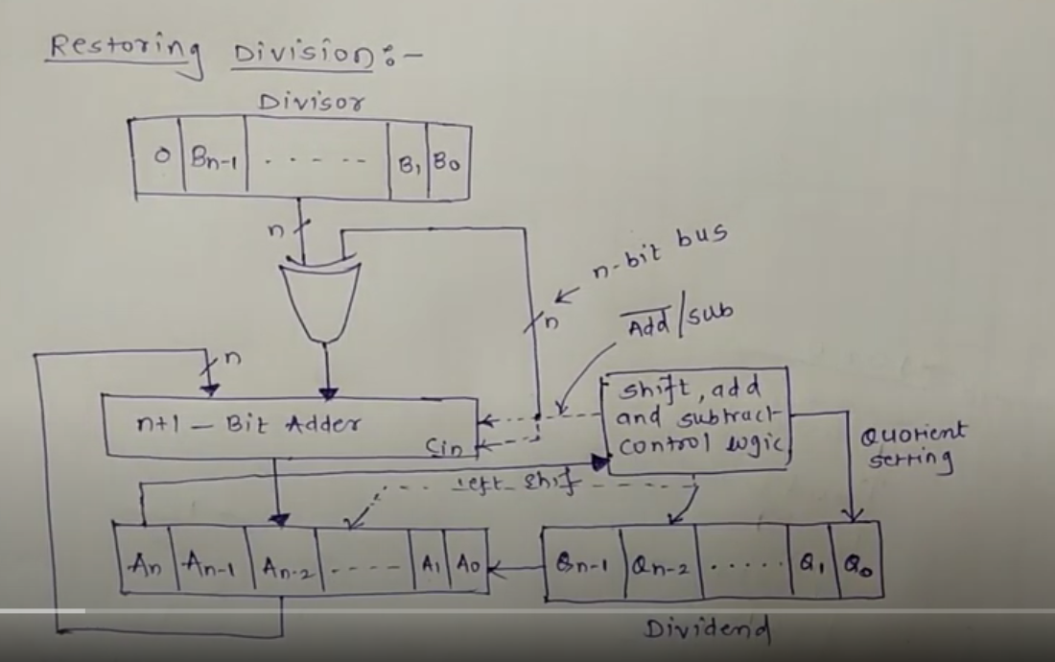

Slide 34
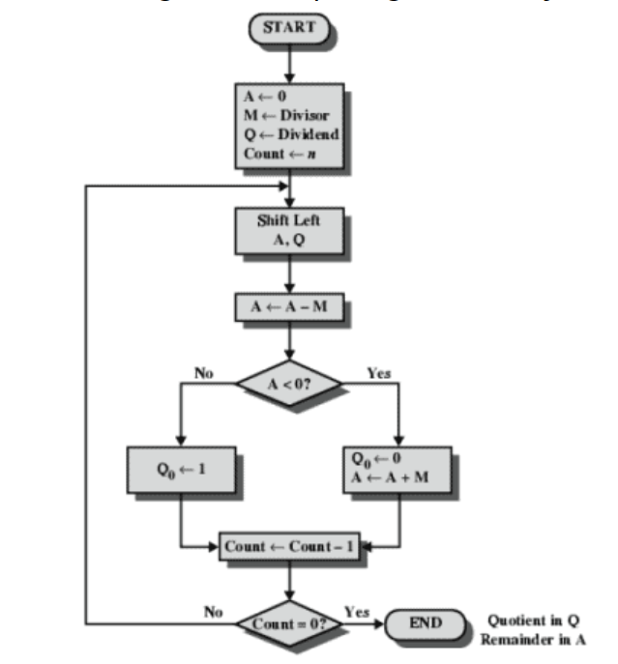

Slide 35
In Summary: Restoring Method

Slide 36
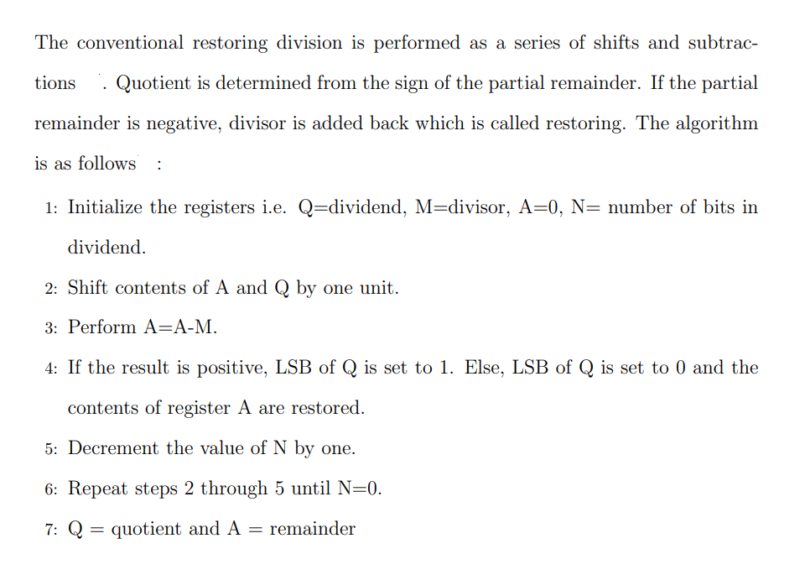

Slide 37
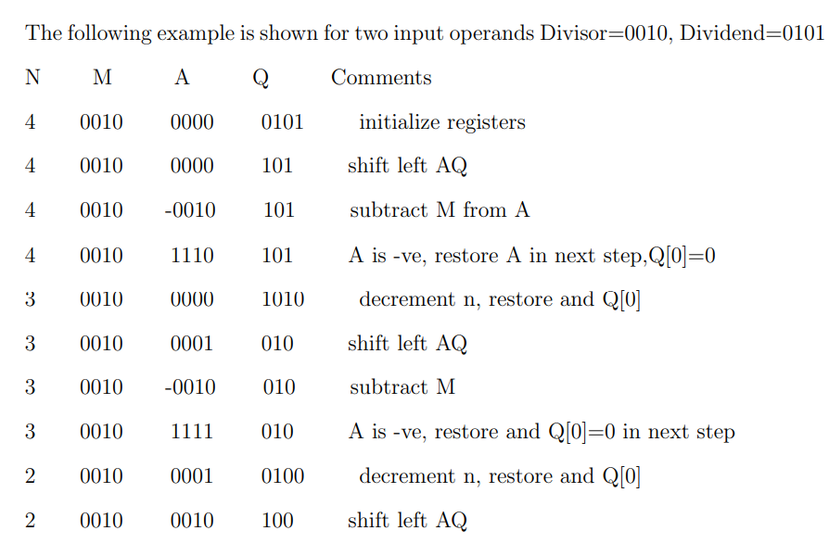

Slide 38
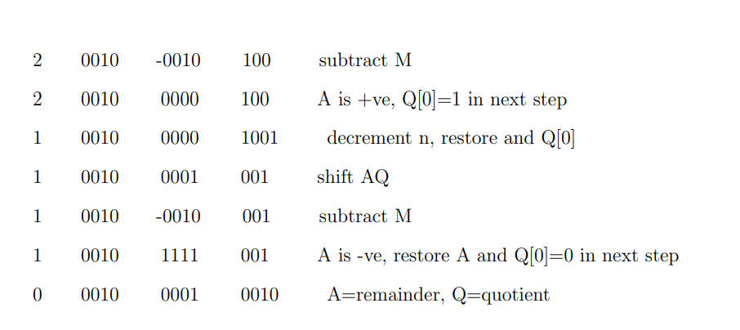

Slide 39
Question
Dividend= 1010
Divisor= 0011
Find remainder and quotient?

Slide 40
Non-Restoring Division Algorithm

Slide 41
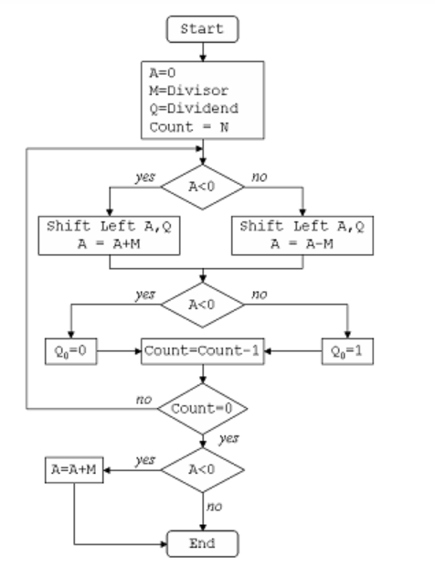

Slide 42
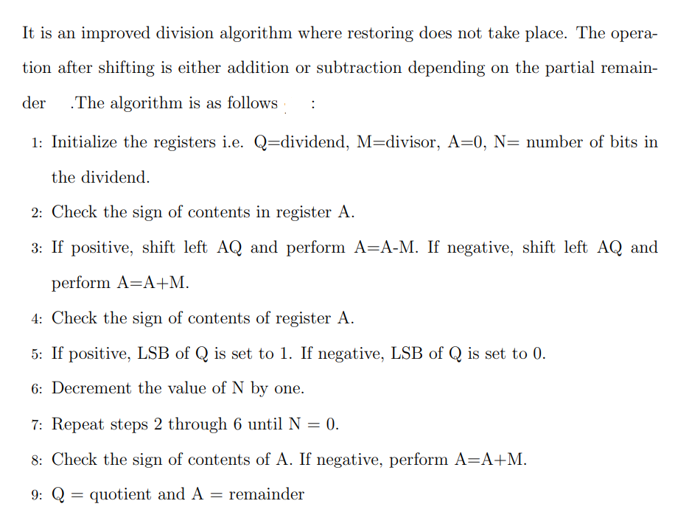
In Summary: Non-Restoring

Slide 43
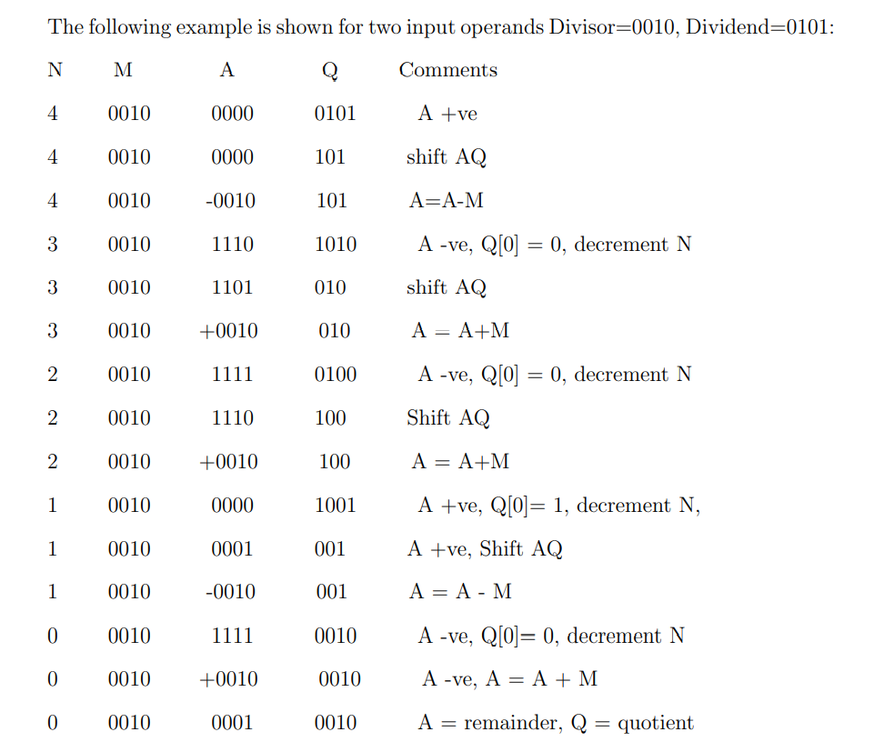

Slide 44
Question
Dividend= 1011
Divisor= 0101
Find remainder and quotient?

